Slide 1
The plasma membrane
The Fluid mosaic model

Slide 2
Importance
The plasma membranes that surround cells may be the most important part of the cell.
Cellular membranes were probably the first structures of living organisms to evolve. The cell membrane is the only cellular structure that is found in all of the cells of all of the organisms on Earth.
The basic function of cell membranes is to separate the vital chemicals and structures needed to maintain the cell.
Notes:
Membranes surrounding the nucleus, endoplasmic reticulum, mitochondria, chloroplasts, lysosomes and vacuoles, separate DNA, enzymes, secretory products of cells, cytoplasm and energy processing materials.

Slide 3
Internal vs external
The membrane forms a boundary between the internal environment of the cell, the cytoplasm and its external environment.
The plasma membrane is selectively permeable meaning that it controls the movement of substances into and out of cells.
Cells also exchange substances within their external environment in the extracellular fluid.

Slide 4
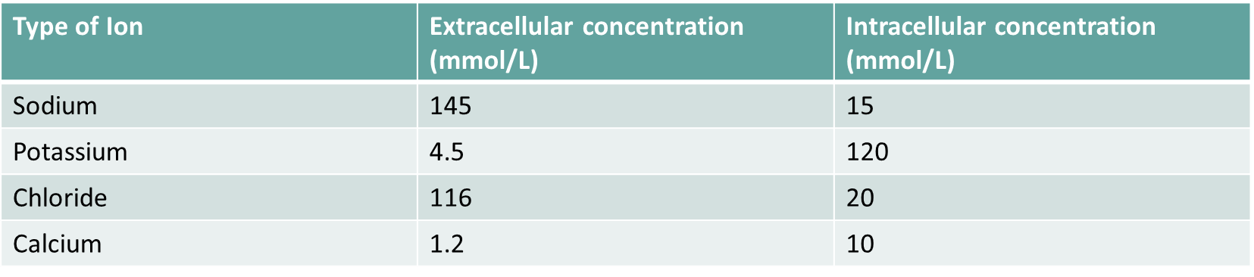
Comparison of the concentration of various ions inside and outside the cell

Slide 5
Permeability
Three factors affect the permeability of a cell membrane:
heat
ethanol
pH
Notes:
A temperature exceeding the optimum and pH levels beyond the normal range can denature the membrane’s proteins. Ethanol dissolves the lipid components of the membrane. This all makes the membrane far more permeable acting as if it is full of holes.

Slide 6
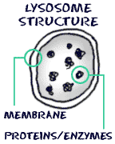
lysosomes
Lysosomes are specialised vesicles that hold enzymes. These lysosomes float around in the cytoplasm until they are needed by the cell. The pH inside and outside of the organelle are able to be different because of this.

Slide 7
The cell membrane is a fluid mosaic
The plasma membrane is consisted of four different type of molecules:
Phospholipids.
Cholesterol.
Proteins.
Carbohydrates.
These molecules are arranged into the Fluid Mosaic Model. Mosaic referring to something that contains many different parts.

Slide 8
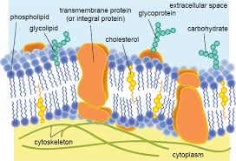
Fluid Mosaic model
The fluid mosaic model describes the structure of a cell membrane.
The cell membrane is not solid. It is flexible and all the individual molecules are just floating in a fluid medium, and they are all capable of moving sideways within the cell membrane.

Slide 9
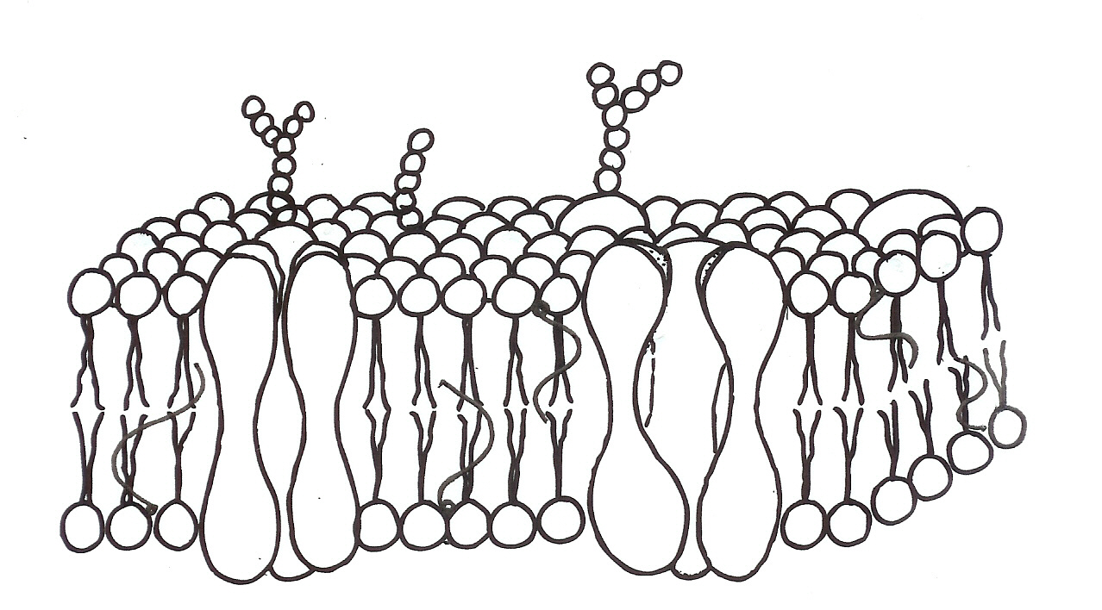
The bi-layer
Membrane protein
Hydrophilic phosphate
TISSUE FLUID
Hydrophobic lipid tail
PHOSPHOLIPID
BI-LAYER
CYTOPLASM

Slide 10
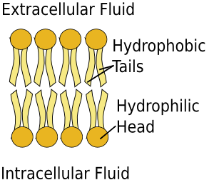
Phospholipids
A single phospholipid molecule has two different ends: a head and a tail. The head end contains a phosphate group and is hydrophilic.
The tail end is made up of fatty acid chains. These chains are hydrophobic.
The phospholipids are arranged in a double layer called the lipid bilayer.
Notes:
The hydrophilic phosphate heads are always arranged so that they are near water. Watery fluids are found both inside a cell (intracellular fluid) and outside a cell (extracellular fluid). The hydrophobic tails of membrane phospholipids are organized in a manner that keeps them away from water.

Slide 11
Cholesterol
cholesterol molecules
    Are hydrophobic.
    Strengthen the membrane by preventing some small molecules from crossing it.
    They ensure that the cell membrane stays fluid and flexible.

Slide 12
PROTIENS
Proteins
    proteins located in the lipid bilayer and are called integral proteins.
    Other proteins, called peripheral proteins, are outside of the lipid bilayer.

Slide 13
CARBOHYDRATES
Carbohydrates
    Found on the outer surface of all eukaryotic cell membranes. Either attached to the membrane proteins or phospholipids.
    Proteins with carbohydrates attached are called glycoproteins.
    Phospholipids with carbohydrates attached are called glycolipids.
    The glycocalyx is involved in protection and cell recognition, and antigens.
Notes:
Glycocalyx is a carbohydrate-enriched coating that covers the outside of many eukaryotic cells and prokaryotic cells, particularly bacteria. In eukaryotic cells the glycocalyx can be used for the recognition of the cell. Bacteria use it for a protective coating from host factors.

Slide 14
The fluid mosaic model of the plasma membrane:
The proteins can move freely through the lipid bilayer.
The ease with which they do this is dependent on the number of phospholipids with unsaturated fatty acids in the phospholipids.

Slide 15
Functions of the cell membrane
The cell membrane:
Isolates the cell from the surrounding tissue fluid
determines what substances enter and leave the cell
contains a variety of receptors that respond to substances in the cell’s environment e.g. hormones, antigens.

Slide 16
Diffusion through the membrane
Because the cell membrane is fatty, most water soluble substances cannot diffuse through it.
Exceptions include oxygen & carbon dioxide.

Slide 17
Membrane proteins
A variety of proteins are embedded in the bi-layer.
These serve various functions including the movement of substances in and out of the cell.

Slide 18
Membrane transport proteins
Membrane proteins that aid the movement of substances in and out of the cell include:
    Channel proteins (ion channels) –
    open channels that allow simple diffusion.
    Carrier proteins that allow facilitated diffusion (e.g. glucose) and active transport (specific membrane pumps).

Slide 19
Membrane transport
Transport processes are either passive or active.
Passive processes require no cellular energy and include diffusion, osmosis & facilitated diffusion.
Active processes require ATP and include specific membrane pumps and phagocytosis/pinocytosis.

Slide 20
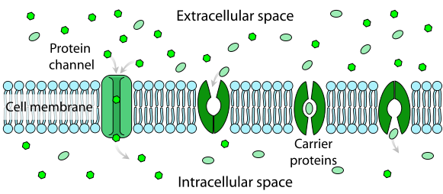
Simple diffusion (left) & facilitated diffusion
Diagram created by LadyofHats

Slide 21
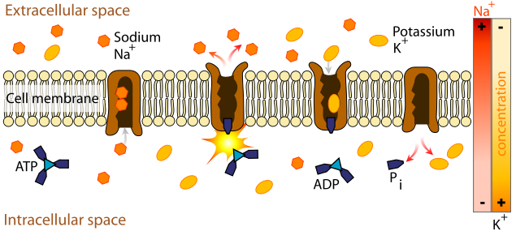
Active transport (sodium pump)
Diagram created by LadyofHats

Slide 22
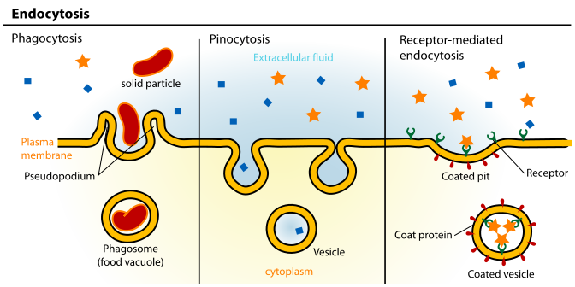
Endocytosis
Diagram created by LadyofHats

Slide 23
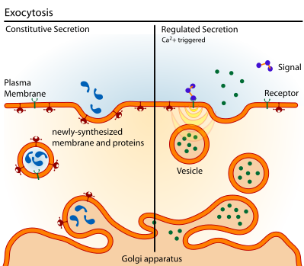
Exocytosis
Diagram created by LadyofHats

Slide 24
Cell markers and receptors
Various protein and carbohydrate molecules exposed on the surface of the membrane:
act as markers – these indicate to cells of the immune system whether a cell is norm or abnormal (see MHC proteins).
serve as receptors that interact with substance in the cell’s environment and initiate specific cellular responses e.g. receptors sensitive to the hormone insulin alter the rate of glucose intake.

Slide 25
Fat-soluble organic molecules can diffuse through the bilayer but polar molecules require proteins
Fat-soluble molecules
Polar molecules
Extracellular
space
Cytosoplasm
(aqueous)
hydrophilic pore

Slide 26
The membrane contains many types of protein:
carbohydrate chain
Glycocalyx: For cell recognition so cells group together to form tissues
Receptor: for recognition by hormones
glycoprotein
Enzyme or signalling protein
integral protein
carrier protein
peripheral protein
hydrophilic channel

Slide 27
There are different types of carrier proteins in the membrane:
ATP
Carrier protein
(passive)
Gated-channel protein
Channel protein
Carrier protein
(active)

Slide 28
Summary
The unit membrane consists of a phospholipid bilayer
Phospholipids consist of a polar, hydrophilic phosphate head and a non-polar, hydrophobic tail consisting of fatty acid chains.
Proteins also occur in the membrane and float freely throughout it.
The model for membrane structure is known as the fluid mosaic model.
Peripheral proteins occur on the inner or outer face of the membrane and integral proteins extend through both lipid layers.
Membrane bound enzymes occur allowing structured metabolic pathways.

Slide 29
Summary
Glycoproteins form the glycocalyx and allow cell to cell recognition.
Receptor proteins can act as binding sites for hormones and other substances and can transmit the information to the interior of the cell.
A variety of carrier proteins allow for the controlled movement of substance through the membrane using both passive diffusion or active transport.
Non-polar, lipid soluble molecules diffuse through the phospholipid bilayer.
Ionic, polar molecules require carrier proteins to enable them to pass through the membrane.
Membrane structure loses integrity with high temperature or presence of organic solvents such as alcohol, thereby increasing permeability.

